Slide 1
Angular Upskilling Program
Forms Module
Template Driven Forms

Slide 2
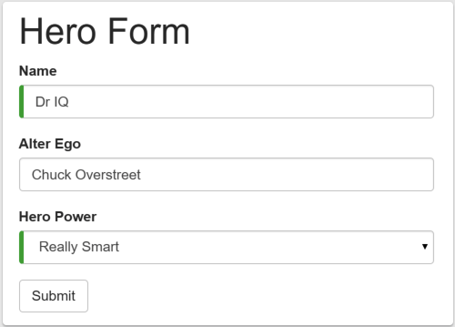
Need of Forms
Definition: Forms represents a way to create interaction between the end user and a web application by collecting input data.
It’s probably one of the most dangerous functionalities supported by web applications from a security point of view.
Angular supports two types of forms:
Template driven forms
Reactive Forms

Slide 3
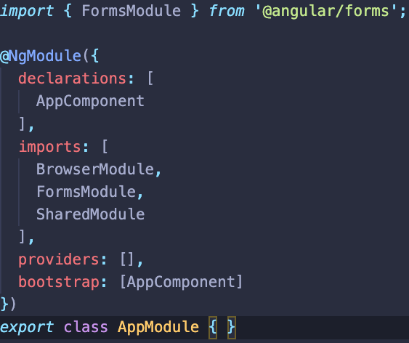
Template Driven Forms
Automatically creates two way data binding between template and component by using the ngModel directive.
It is not supported out of the box due to the modularity system provided by the framework.
To support the ngModel directive FormsModule should be imported.

Slide 4
ngModel directive
It creates the two way data binding mechanism between the template and component.
Abstraction between event type and event handler – you don’t need to know what is the correct event that should be put on the input HTML element
Could be monitorized in real time with a special event handler triggered for ngModelChange event.

Slide 5
Form Fields States
Template driven forms are tracking the field in three states:
Touched or untouched;
Valid or invalid;
Pristine or dirty;
Following CSS classes are supported:
.ng-valid – tells if the form input is valid according to used validators;
.ng-invalid – tells if the form input is invalid according to used validators;
.ng-pristine – tells if the form input has NOT been modified by the user;
.ng-dirty – tells if the form input has been modified by the user;
.ng-untouched – tells if the form input has not lost focus yet.
.ng-touched – tells if the input has focus

Slide 6
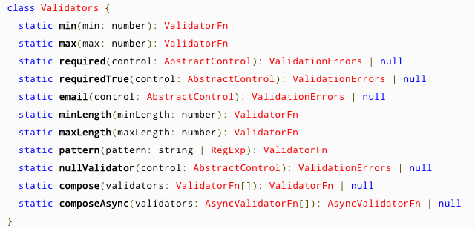
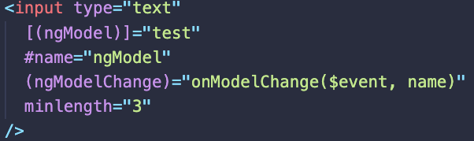
Form Validation
Form validation in template driven forms is done by using directives.
There are a series of built-in validators that can be used but custom validators can be created aswell.

Slide 7
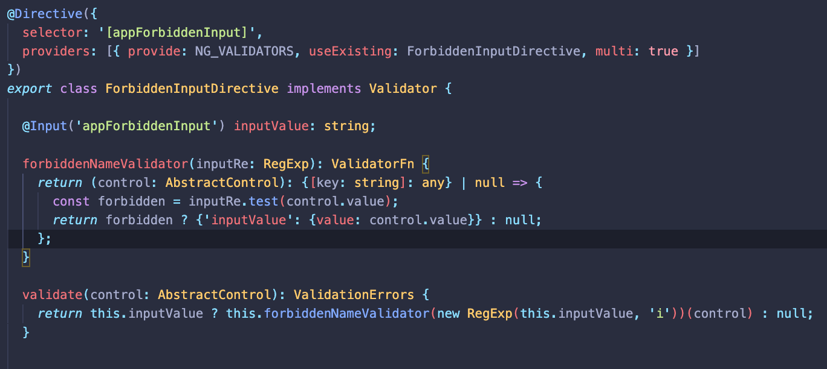
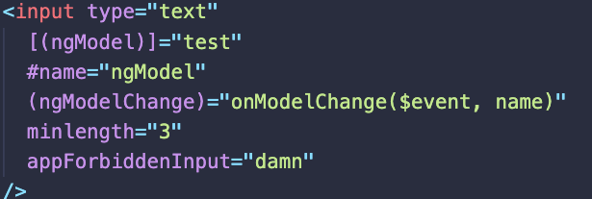
Custom Validators
For defining a custom validator a directive that implements Validator interface needs to be defined.
Note: You may have noticed that the custom validation directive is instantiated with useExisting rather than useClass. The registered validator must be this instance of the ForbiddenInputDirective—the instance in the form with its inputValue property bound to “damn". If you were to replace useExisting with useClass, then you’d be registering a new class instance, one that doesn’t have a inputValue set.

Slide 8


